Slide 1


Slide 2
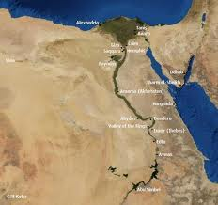

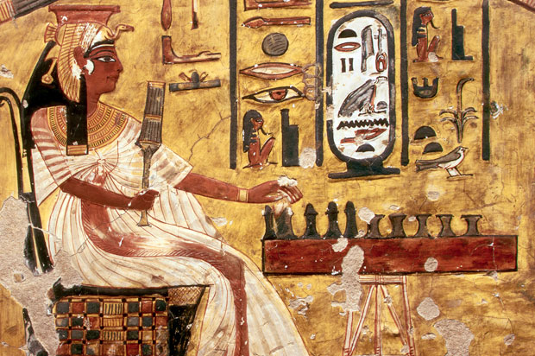
Introduction to
Research Ethics in Egypt
Dr. Wafaa E. Abdel-Aal
Professor of Pathology
Manager of CTU
National Research Center (NRC)
Menofia U 8th September 2015

Slide 3
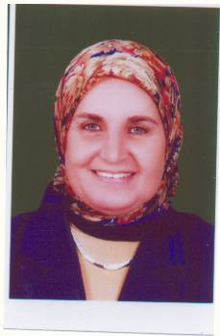
Professor of Pathology, Medical Division, NRC.
Moderator of Medical Research Ethics Committee, NRC
Manager of Clinical Trial Unit of Medical Research Centre of Excellence.
Certified Trainer of Research Ethics, Maryland University School of Medicine, USA.
Member of UNESCO Regional Documentation and Information Center on Bioethics and Ethics of Science and Technology the Arab Region (RDIC- BEST).
Member of Research Ethics Committee of General Organization for Teaching Hospitals and Institutes (GOTHI) Member of IACUC of Faculty of science, Cairo University.
Visiting lecturer of Pathology in Faculty of Physical Therapy, Cairo University.
Publications of 4 books in the field of Pathology & two books and 3 booklets in the field of research Ethics.
Supervision of 24 theses.
68 publications.
Organized & shared in organization of more than 60 workshops and Training Courses on research Ethics.
Dr. Wafaa
Abdel- Aal

Slide 4
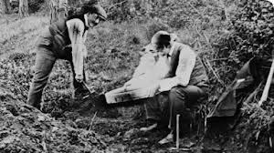
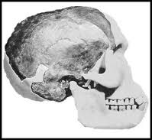
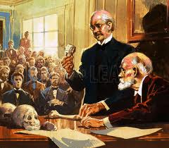
Research Misconduct
Two British scientists. In 1912, Charles Dawson and Arthur Smith Woodward produced fragments of the skull of the so-called Piltdown Man, claimed to be discovered by workmen in gravel pits in Sussex.
They suggested that Piltdown man represented an evolutionary missing link between ape and man.
It was after 40 years that Piltdown Man was shown to be a composite forgery. It was made out of a medieval human skull, the 500-year-old lower jaw of an orangutan, and chimpanzee fossil teeth.

Slide 5
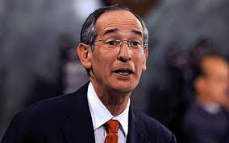


Human experiments:
First, do harm
فى أكتوبر 2010, قام الرئيس أوباما بالاعتذار رسميا لرئيس جواتيمالا على التجارب الطبية المخزية التى قام بها أطباء أمريكيون على مواطنين فى جواتيمالا قاموا فيها بحقن العديد من السجناء والاطفال بالبكتريا المسببة لأمراض تناسلية فى الفترة من 1946 إلى 1948

Slide 6

Outline
Introduction
What is a clinical trial & pre-clinical studies?
Current Situation in Egypt:
- Guidelines and Laws in Egypt
- RECs in Egypt & The ENREC
- National Research Centre of Egypt & its REC
Challenges of Research Ethics in Egypt
Future Expectations

Slide 7


Research Ethics & Bioethics
  Research Ethics is the ethics of the planning, conduct, and reporting of research. It is clear that research ethics should include: Protections of human and animal subjects.
  Bioethics is the Study of the ethical issues arising from health care, biology, technologies and medical sciences.

Slide 8
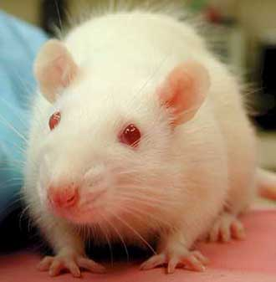

Research Ethics
Human Research Ethics
Pre-clinical Trials
Animal Research Ethics
Clinical Trials

Slide 9
Clinical Trials
التجارب الاكلينيكية
What is a clinical trial?
A clinical trial is a research study in which a treatment or therapy is tested in people to see whether it is safe and effective.
Clinical trials are an important part of the medical research process. Through clinical trials, scientific discoveries can lead to better ways to prevent, detect, and treat diseases and medical conditions.

Slide 10
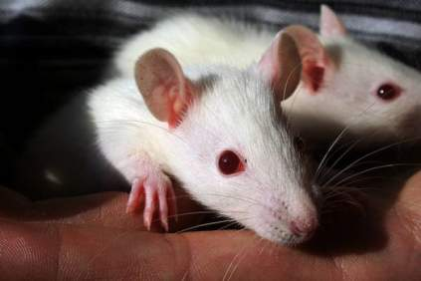
What is a Preclinical Trial?
تجارب ماقبل الاكلينيكية
It is a laboratory test of a new drug or a new medical device, usually done on animal subjects, to see if the hoped-for treatment really works and if it is safe to test on humans.

Slide 11
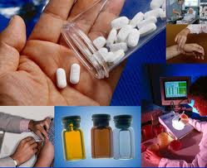

Importance of pre-clinical
studies & Clinical Trials
Pre-Clinical Trials and Clinical Trials are the processes by which scientists test drugs and
devices to see if they are SAFE and EFFECTIVE.
It is mandatory to harmonize all aspects of drug according to the ethical principles of medicine and animal protection.

Slide 12
Current Situation of
Research Ethics in Egypt
Since the 1980s Egypt has hosted a number of regional and international conferences, dealing with Research Ethics.
several Egyptian universities and research centers established ethical committees and they are very active in improving the quality of their performance through networking and training programs

Slide 13
A Project between Egypt and Maryland University, USA was initiated in 2005- 2008 to train Egyptian Researchers on Research Ethics, about 40 Egyptians were trained.
A law on biomedical research and clinical trial is being prepared in Egypt by a committee of experts from the three Ministries: Health & Population, High Education and Science and Technology. We hope to have this law soon.

Slide 14
Current Situation of Research Ethics in Egypt Guidelines and Laws in Egypt
Although there are no national regulations for ethics in Egypt, there are two general documents that contain some paragraphs about research ethics:
- The Egypt Constitution 2014, Articles 51&60
- Profession Ethics Regulations issued by the Minister of Health & Population No. 238/2003, Articles 52–6121.
The Declaration of Helsinki is one of the most widely known and accepted guideline documents for research ethics committees in Egypt.

Slide 15
المبادىء العامة لأخلاقيات البحوث الطبية
Principles of Medical Research Ethics
(1)
حـق الاختيـار
Autonomy
(2)
المنفعة والاحســـان
Beneficence Non-
malifecence
(3)
العــد ل
Justice
The right to make
a decision
informed consent
Hippocratic tradition
“first do no harm”
Minimize harms
Maximize benefits
Favorable risk/benefit ratio
Fairness in distribution
of risks and benefits
. Fairness in selection of
human subjects

Slide 16

دستور جمهورية مصر العربية
2014
الكرامة حق لكل إنسان، ولا يجوز المساس بها، وتلتزم الدولة باحترامها وحمايتها. | مادة 51
لجسد الإنسان حرمة، والاعتداء عليه، أو تشويهه، أو التمثيل به، جريمة يعاقب عليها القانون. ويحظر الاتجار بأعضائه، ولا يجوز إجراء أية تجربة طبية، أو علمية عليه بغير رضاه الحر الموثق، ووفقًاً للأسس المستقرة فى مجال العلوم الطبية، على النحو الذى ينظمه القانون. | مادة 60

Slide 17
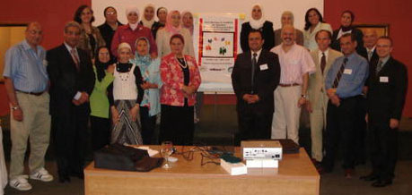
Egyptian Network of Research
Ethics Committees (ENREC)
Established in 2008 to raise the harmonization between Egyptian RECs in sharing of information and intellectual resources, policies and review strategies.
There are 55 RECs in
different universities
and research center in
Egypt. 33 RECs are
members of ENREC.

Slide 18
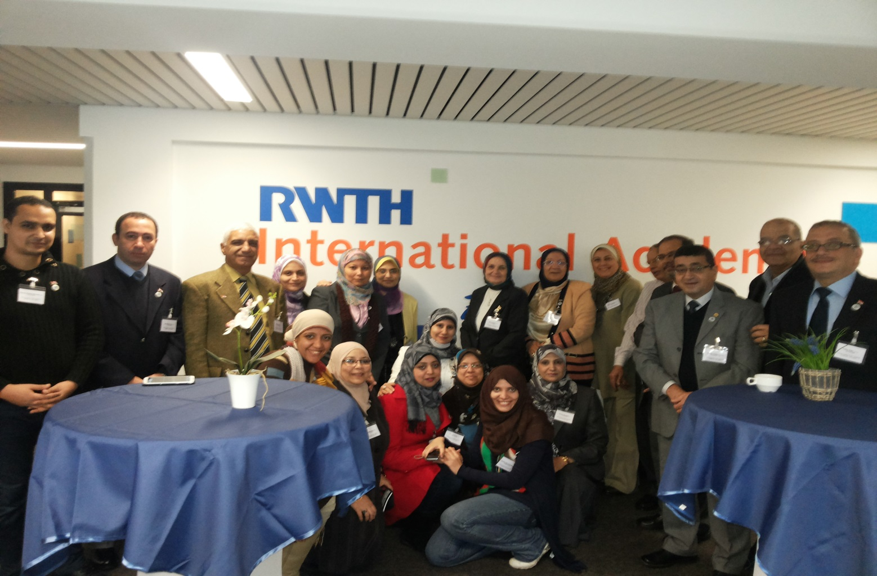
First ICACUC in Egypt

Slide 19
National Research Center (NRC)
Cairo Egypt
NRC Is a multidisciplinary R&D center in Egypt devoted to basic and applied research within the major fields of interest.
NRC Consists of 16 divisions and 111 departments covering the major areas of industry, health, environment, agriculture, basic sciences and engineering.

Slide 20
Policy of National Research Center for Capacity building of Research Ethics
Established the Medical Research Ethics Committee in 2003.
Organized many workshops & Training courses for dissemination of ethics awareness between physicians & researchers.
Opening the new building of Medical Research Center of Excellence
Established the Clinical Trial Unit (CTU) in the new building (2013)
Memorandum of Understanding between Quintiles Egypt and NRC in 15th May 2013

Slide 21
1- MREC of NRC
Aim
Protect human rights
Minimize harms
3. Ensure justice
Public Trust
REC Mission
The purpose of the MREC is to protect the rights, safety,
and welfare of all research and animal subjects.

Slide 22
MREC of National Research Centre
The Medical Research Ethics Committee (MREC) of the NRC was established in 2003 aiming to review medical research to safeguard the dignity, rights, safety and wellbeing of all research participants.
Its regulatory rules were based on the Declaration of Helsinki and WHO regulations.
Rules and regulations of animal research ethics were established with the use of 3 Rs (replacement, reduction and refinement)

Slide 23
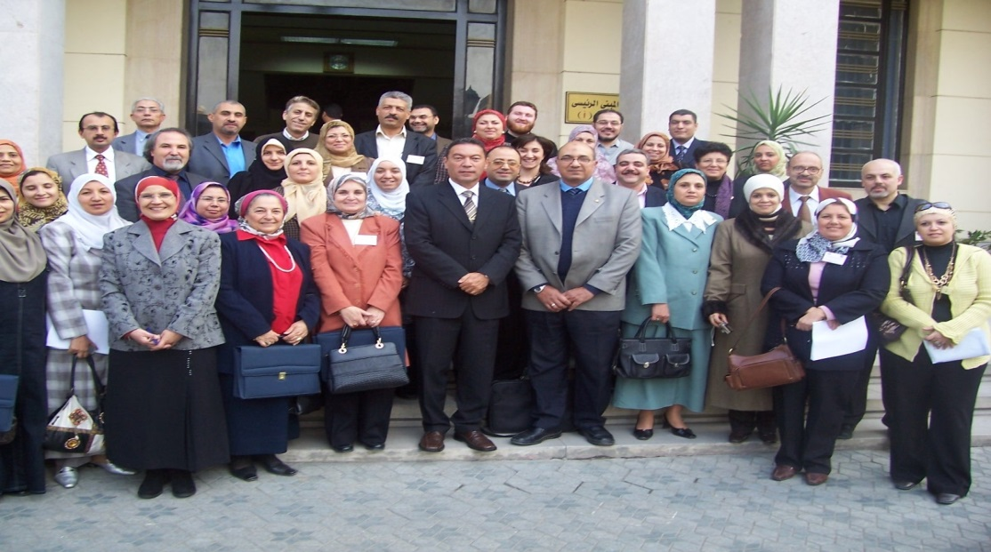
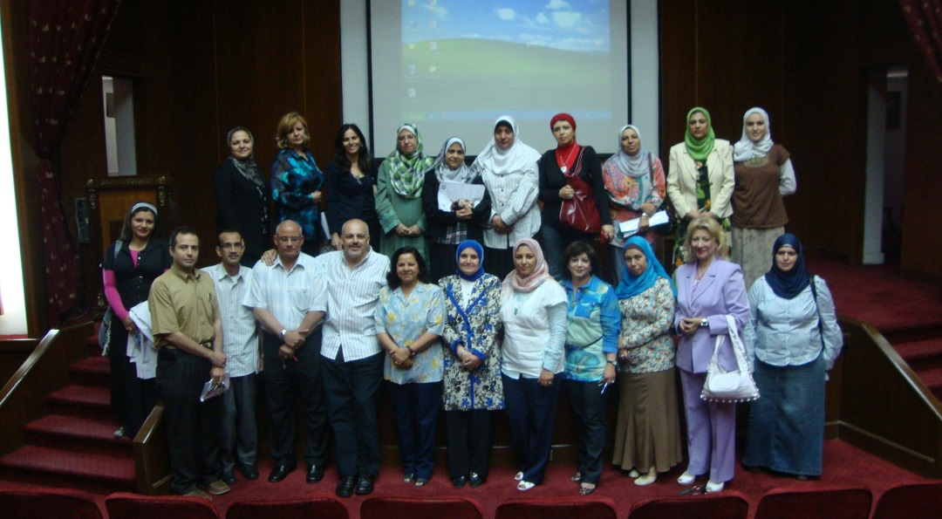
2- Training Activity of
Research Ethics in NRC
Research ethics workshops, training courses and seminars have been held in the NRC to create awareness and insure conforming to international guidelines for research.
NRC 2008
NRC 2011

Slide 24
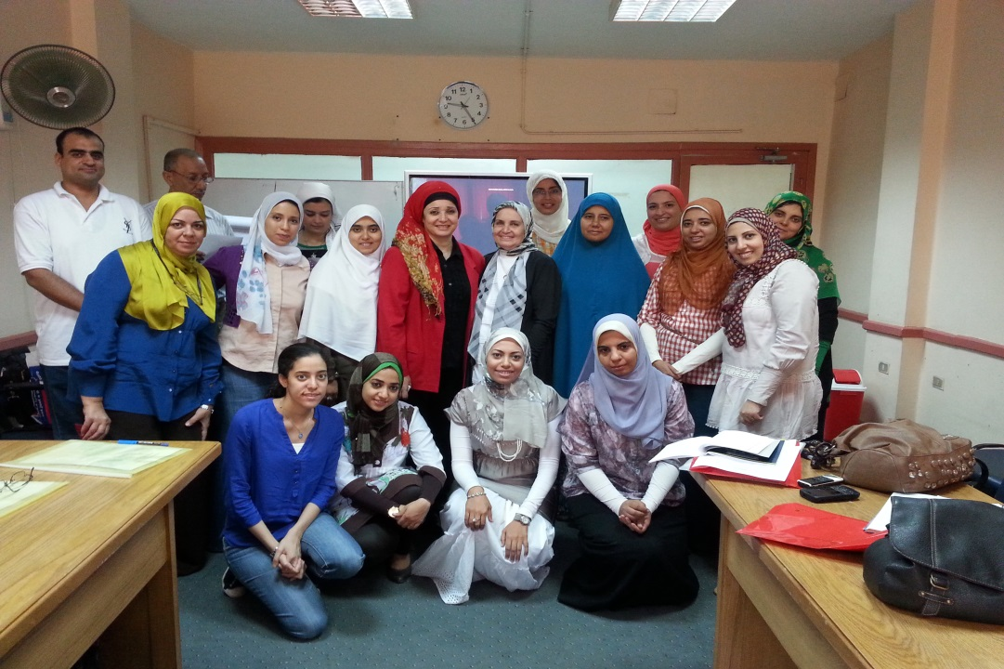
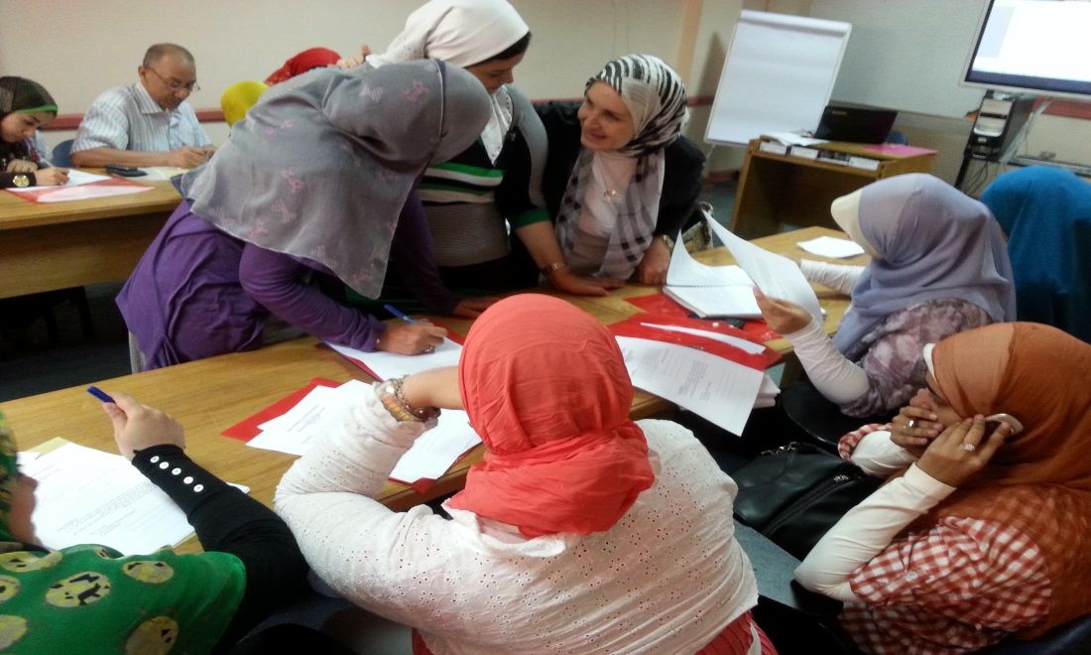
Training Course on
“Research Ethics & Clinical Trial”
29 September 2013

Slide 25

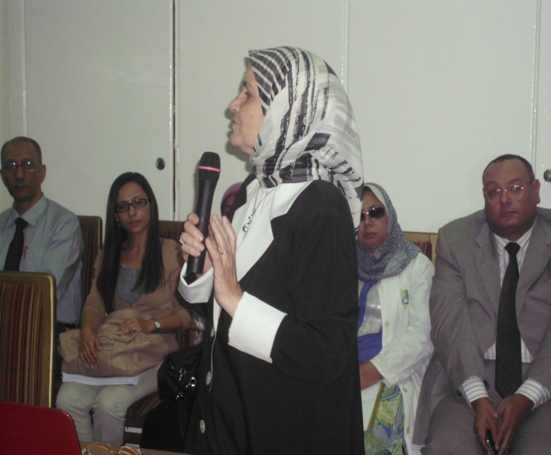
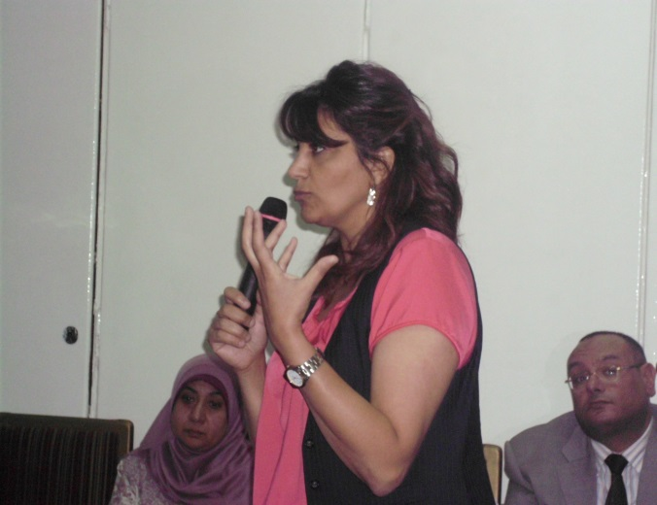

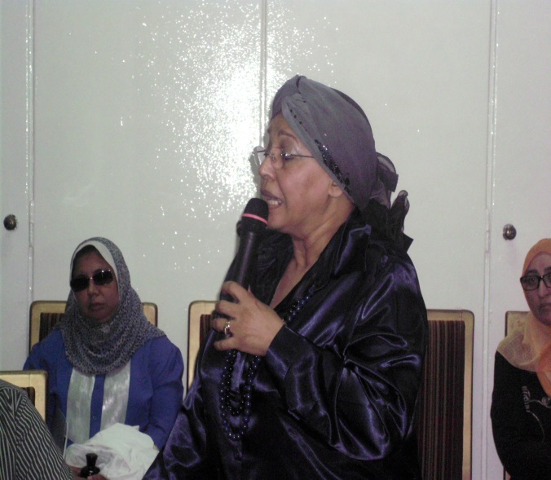
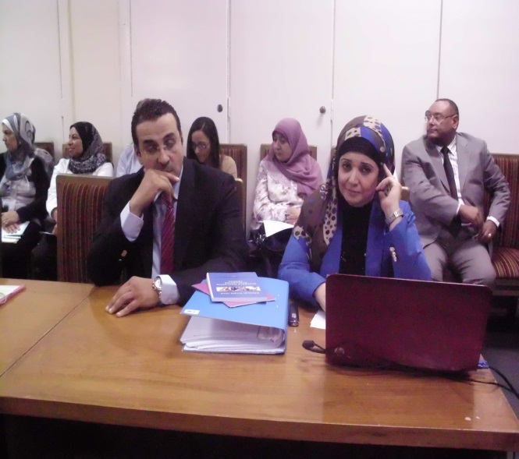
CT Conference, NRC, Egypt, 28th October 2013
Cairo University
NRC
Quintiles Egypt
Alexandria University
Ministry of Health Egypt
Novartis Company

Slide 26
Training Courses and workshops held in NRC during the years 2006 to 2013
Year 2006 … 4 Workshops … 220 Trainee
Year 2007 … 1 Workshop … 140 Trainee
Year 2008 … 8 Workshops … 182 Trainee
Year 2009 … 4 Workshops … 47 Trainee
Year 2010 … 4 Workshops … 184 Trainee
Year 2011 … 5 Workshops … 104 Trainee
Year 2012 … 6 Training courses…176 Trainee
Year 2013 … 5 Training courses…140 Trainee
. Year 2014 … 6 Training courses…215 Trainee
Total No of Workshops …42
Total No of Trainees …1408

Slide 27
A Books of SOPs and A Handbook on The clinical Trial Unit were published in 2013 in the NRC.
Book of SOPs
Handbook of CTU

Slide 28
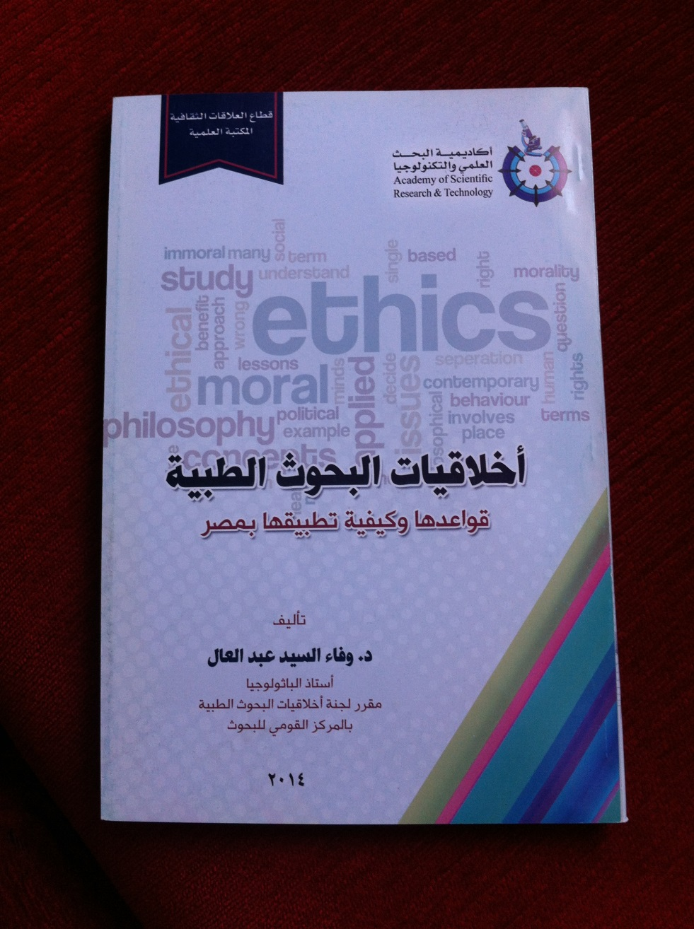
كما أصدرت أكاديمية البحث العلمى والتكنولوجيا كتاب « أخلاقيات البحوث الطبية بمصر « عام 2014

Slide 29

Book chapter of Animal
Research Ethics
in Africa

Slide 30
Challenges of Bioethics in Egypt
Financial, social, and perhaps religious, ethical, and other factors hinder Bioethics in Egypt and Arab countries
  Lack of legislations and laws for Medical Research
  Insufficient funds for public health
  Insufficient access to medical care
  Insufficient control of quality and distribution of medicines
  Illiteracy or language problems in relation to medical and Healthcare communication
  Limited number of qualified investigators and study coordinators

Slide 31
Recommendations
Establishment of National Laws for Clinical Trials and Animal Research Ethics.
Upgrading research infrastructure and equipment
Expanding the role of research ethics committees ( Human & Animals) in all Universities and research centers
Providing high-quality training for Physicians and researchers
- Dissemination of awareness of bioethical issues in society through multi- media

Slide 32
Future Expectations
Key Points to Consider
High authority
Code of Ethics and
Clinical Research
Law
Animal Research Ethics
Law
Institutions
Research Ethics
Committees
Clinical Trial Units
Training of Researchers
Researchers
Learning GCP
Training Courses on
Research Ethics
Community
Awareness about
Importance of
Clinical Trials
Multimedia

Slide 33
Future Expectations
I think and hope that this workshop will serve as a starting point for initiation of IACUCs in all the Egyptian universities and research centers in the near Future .

Slide 34
References
The Constitution of The Arab Republic of Egypt, 11 Sep. 1971. Available at:
http://www.wipo.int/wipolex/en/text.jsp?file_id¼189854
Ministry of Health and Population (Egypt). Profession Ethics Regulations, the Resolution of the Minister of Health & Population No. 238/2003. Cairo, Egypt: Ministry of Health and Population, 2003
Wafaa Abdel-Aal, Esmat Abdel Ghaffar, Osama El Shabrawy ( 2013): Review of the Medical Research Ethics Committee (MREC), National Research Center of Egypt, 2003–2011. Current Medical Research & Opinion 2013, 1–7.

Slide 35
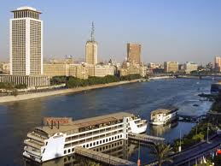

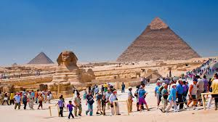

Thank you

