Slide 1
Elective 2
Optimal Control Systems
(ACE 326)
Background
Ref.1&2: Appendix A
Dr. Lamiaa M. Elshenawy
Email: lamiaa.elshenawy@el-eng.menofia.edu.eg
lamiaa.elshenawy@gmail.com
Website: http://mu.menofia.edu.eg/lmyaa_alshnawy/StaffDetails/1/ar

Slide 2
Vector & Matrix Algebra Outlines
Matrices Definition
Matrices Types
Matrices Operations
Solving $n$ Linear Equations /$n$ Unknowns

Slide 3
Vector & Matrix Algebra History
Linear algebra is the branch of mathematics concerning vector spaces/linear mapping between such spaces
Leibniz (1693) Determinants
Gabriel Cramer (1750-Cramer’s rule) solving linear systems
Gauss 1777–1855 solving linear systems by Gaussian elimination method

Slide 4
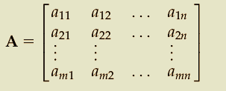
Vector & Matrix Algebra Matrices Definition
A matrix is a rectangular array of quantities (real numbers/complex numbers/functions of variables)
row
column
Matrix $A= {\left[a_{ij}\right]}_{(m×n)}$
Elements of A

Slide 5
Vector & Matrix Algebra Matrices Types
Rectangle matrix
$$A= {\left[a_{ij}\right]}_{(m×n)}$$
Square matrix
$$m=n A= {\left[a_{ij}\right]}_{(n×n)}$$
Vector
$m=1 A= {\left[a_{ij}\right]}_{(1×n)}$= a (row vector)
$n=1 A= {\left[a_{ij}\right]}_{(m×1)}$= a (column vector)

Slide 6
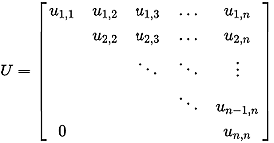
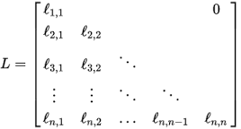
Vector & Matrix Algebra Matrices Types
Upper triangular matrix
Lower triangular matrix

Slide 7
Vector & Matrix Algebra Matrices Types---Cont.
Null Matrix
$$A= {\left[a_{ij}\right]}_{(m×n)}=0$$
$$AB=BA=0$$
Unity Matrix (Identity Matrix)
$$A=I=I_{n}={\left[a_{ii}\right]}_{(n×n)}=1; i=1:n$$
Singular Matrix/Nonsingular Matrix
$\left|A\right|=0$
$\left|A\right|≠0$
Determinant of A-
Full rank
Symmetric Matrix
$$A={ A}^{T}$$

Slide 8
Vector & Matrix Algebra Matrices Operations
Addition
$$C_{(m×n)}=A+B; c_{ij}=a_{ij}+b_{ij}$$
Properties
Commutative
$$A+B=B+A$$
Associative
$A+\left(B+C\right)=(A+B)+$C
$A+C=B+$C
$$A=B$$
$a_{ij}=b_{ij}$
$$A_{(m×n)}=B_{(m×n)}$$

Slide 9
Vector & Matrix Algebra Matrices Operations
Multiplication
$$C_{(m×p)}=A_{(m×n)}B_{(n×p)}; c_{ij}=\sum_{k=1}^{n}{a_{ik}b_{kj}}$$
Properties
Commutative
$$AB≠BA$$
Associative
$A\left(BC\right)=(AB)$C
Distributive
$A\left(B+C\right)=AB$+AC
$\left(A+B\right)C=AC$+BC
$$\left(A+B\right)\left(C+D\right)=AC+AD+BC+BD$$

Slide 10
Vector & Matrix Algebra Matrices Operations
Transpose of a matrix flips a matrix over its diagonal
$$A^{T}=A^{′}$$
Properties
${ (A^{T})}^{T}=A$
${ (A+B)}^{T}={ A}^{T}+{ B}^{T}$
${ (αA )}^{T}={ αA}^{T};α scalar$
${ (AB)}^{T}={{ B}^{T}A}^{T}$

Slide 11
Vector & Matrix Algebra Matrices Operations---Cont.
$a^{T}b=a .b=\sum_{j=1}^{n}{a_{j}}b_{j}$
Dot product
vectors
$${{(a}^{T}a)}^{1/2}=\left\|a\right\|={\left(\sum_{j=1}^{n}{{a_{j}}_{}^{2}}\right)}^{1/2}$$
Norm
vector length-scalar

Slide 12
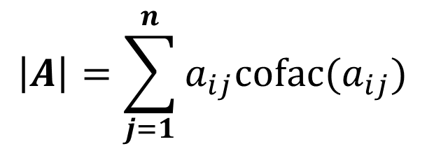
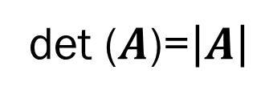
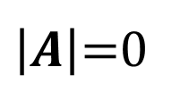
Vector & Matrix Algebra Matrices Operations---Cont.
Determinant is a scaling factor of a matrix
det ($A$)=$\left|A\right|$
$$\left|A\right|=\sum_{j=1}^{n}{a_{ij}cofac(a_{ij})}$$
$cofac\left(a_{ij}\right)={\left(−1\right)}^{i+j}\left|A_{ij}\right|$
f$or any i or j$
Properties
$\left|A^{T}\right|=\left|A\right|$
If a square matrix A has two identical columns (rows)/elements of a column ( row) are zero
$\left|A\right|$=0
$\left|A\right|$=$\prod_{i=1}^{n}{a_{ii}}$
upper/lower triangular matrix

Slide 13
Vector & Matrix Algebra Matrices Operations---Cont.
Inverse of a matrix
(${A\text{)}}^{−1}$= $\frac{1}{\left|A\right|} adj(A)$
$$adj(A)={(cofac(a_{ij}))}^{T}$$
Properties
${{(A}^{−1})}^{−1}=A$
${{(A}^{−1})}^{T}={{(A}^{T})}^{−1}$
${\left|A\right|}^{−1}=\left|{A }^{−1}\right|$
${ (αA )}^{−1}={ α^{−1}A}^{−1};α nonzero scalar$

Slide 14
Vector & Matrix Algebra Matrices Operations---Cont.
Elementary row/column operations
Interchange any two rows (columns).
Multiply any row (column) by a nonzero scalar.
Add to any row (column) a scalar multiple of another row (column).

Slide 15
Vector & Matrix Algebra Solving $n$ Linear Equations/$n$ Unknowns
Linear equations are encountered in numerous engineering and scientific applications
Dummy variables
Augmented matrix

Slide 16
Vector & Matrix Algebra Solving $n$ Linear Equations/$n$ Unknowns
Let two linear equations:
$a_{11}x_{1}+a_{12}x_{2}$=$b_{1}$
$a_{21}x_{1}+a_{22}x_{2}$=$b_{1}$
$$Ax=b$$
Elimination Process

Slide 17
Vector & Matrix Algebra Solving $n$ Linear Equations/$n$ Unknowns
Cramer’s rule

Slide 18
Vector & Matrix Algebra Summary
Solution of $n×n$ system of linear equations
$\left|A\right|≠0$
Unique solution
$\left|A\right|=0$
Infinite number of solutions/No solution

Slide 19
Vector & Matrix Algebra Solving $m$ Linear Equations/$n$ Unknowns
Matrix rank is largest nonsingular square submatrix of given matrix
$$r$$
$n>m, r≤m$
full row rank matrix-
$∞$ solutions
$m>n, r≤n$
full column rank matrix-
no solution/ $∞$ solutions
$m=n, r=n$
nonsingular matrix-
unique solution

