Slide 1

Elective 2
Optimal Control Systems
(ACE 326)
Lecture 1- Introduction to Optimization Theory
Ref. 1: Chapters 1&2
Dr. Lamiaa M. Elshenawy
Email: lamiaa.elshenawy@el-eng.menofia.edu.eg
lamiaa.elshenawy@gmail.com
Website: http://mu.menofia.edu.eg/lmyaa_alshnawy/StaffDetails/1/ar

Slide 2
Introduction to optimization theory
Outlines
What Is Optimization?
Why Is Optimization?
How Is Optimization?
Optimum Design Problem Formulation

Slide 3
Introduction to optimization theory
What Is Optimization?
Optimization=Best Design
A branch of mathematics encompasses minimization and/or maximization
Pythagoras (569 BC to 475 BC) defined optimum over numbers, geometrical shapes, physics, astronomy
Bellman (1957) introduced optimality principle for dynamic programing problem
Russell C. Eberhart and James Kennedy (1995) Particle Swarm Optimization (PSO)

Slide 4
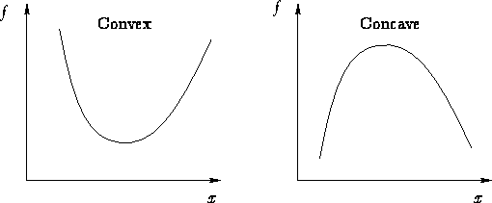


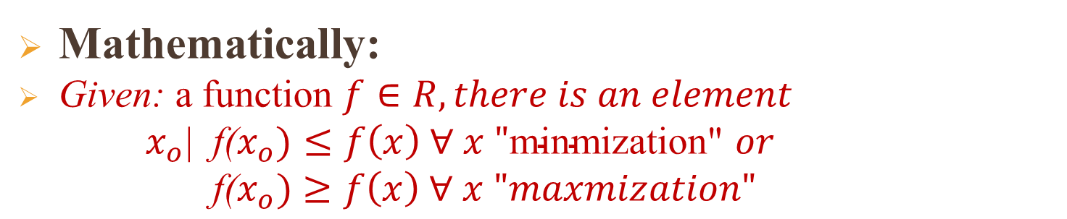


Introduction to optimization theory
What Is Optimization?
Mathematically:
Given: a function $f∈R, there is an element$
$x_{o}\text{|}$f($x_{o})≤f\left(x\right) ∀ x \text{"}\text{minmization}\text{"}$ $or$
$\text{f}\text{(}x_{o})$ $≥f\left(x\right) ∀ x "maxmization"$
maximization
$$\text{f}\text{(}x_{o})$$
$$\text{f}\text{(}x_{o})$$
$$x_{o}$$
$$x_{o}$$
minimization

Slide 5
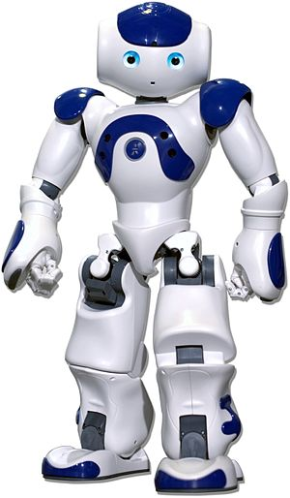
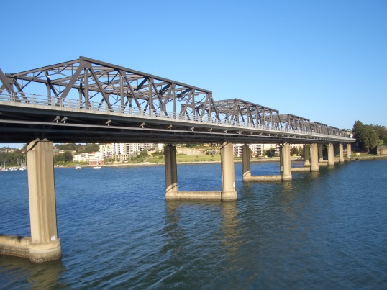
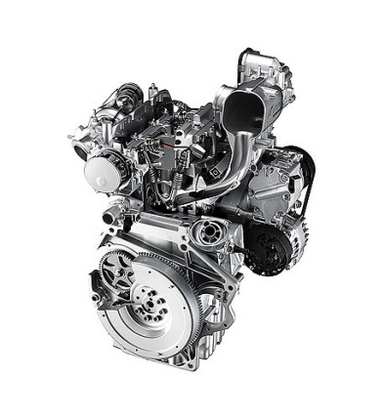
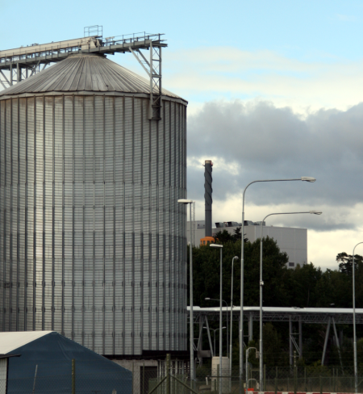

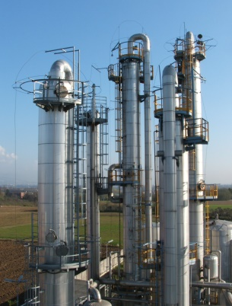
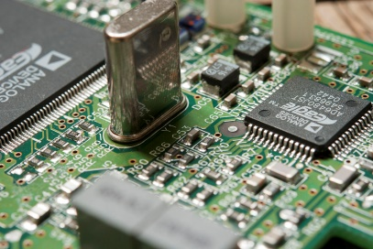
Introduction to optimization theory
Why Is Optimization?
Civil Engineer
Mechanical Engineer
Chemical Engineer
Electronic Engineer

Slide 6
Introduction to optimization theory
Why Is Optimization?
Competitive marketplace
Maximize the load a robot can lift
Design the smallest heat exchanger that accomplishes the desired heat transfer
Design the lowest-cost bridge for the site
Optimization
Strength
Reliability
Longevity
Efficiency
Utilization
Minimization
Maximization
Cost
Energy

Slide 7
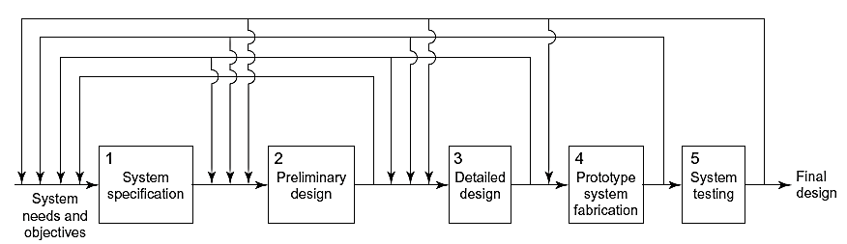
Introduction to optimization theory
How Is Optimization?
System Evolution Model

Slide 8
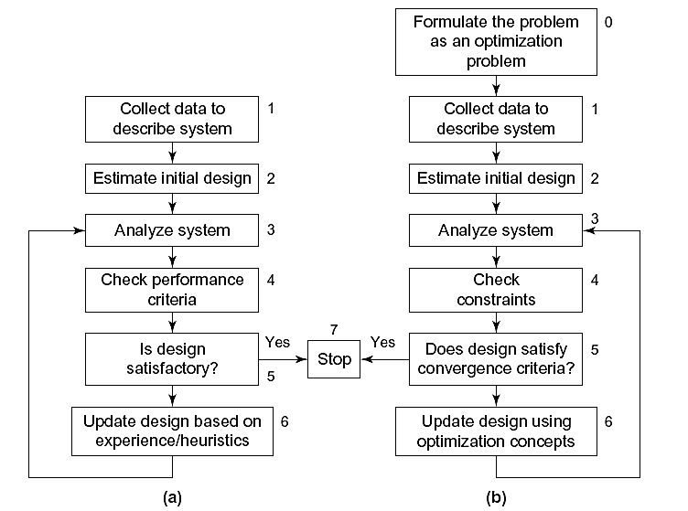
Introduction to optimization theory
How Is Optimization?
(a) Conventional Design Method
(a) Optimum Design Method

Slide 9
Introduction to optimization theory
How Is Optimization?
Optimum Design Steps
Step1: Project/Problem Description
Step2: Data & Information Collection
Step3: Definition of Design Variables
Step4: Optimization Criteria
Step5: Formulation of Constraints

Slide 10
Introduction to optimization theory
How Is Optimization?
Example 1: Design a can to hold at least 400 ml of liquid with the following requirements:
Minimize its manufacturing cost
Diameter should be no more than 8 cm and no less than 3.5 cm
Height should be no more than 18 cm and no less than 8 cm
P.S. Cost is directly related to the surface area of the sheet metal used

Slide 11
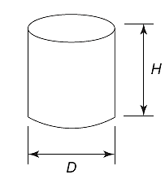
Introduction to optimization theory
How Is Optimization?
Optimum Design Steps
Step1: Project/Problem Description
Step2: Data & Information Collection
Data are given in the problem statement

Slide 12
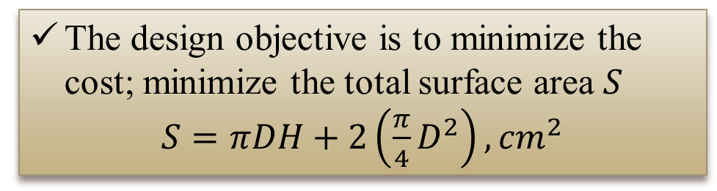
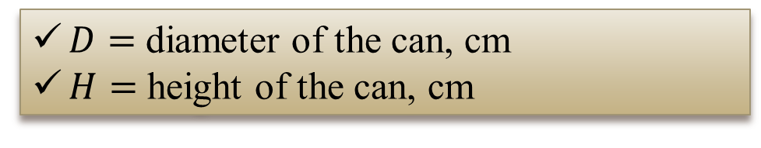
Introduction to optimization theory
How Is Optimization?
Step3: Definition of Design Variables
$D=$ diameter of the can, cm
$H=$ height of the can, cm
Step4: Optimization Criteria
The design objective is to minimize the cost; minimize the total surface area $S$
$S=πDH+2\left(\frac{π}{4}D^{2}\right), {cm}^{2}$

Slide 13

Introduction to optimization theory
How Is Optimization?
Step5: Formulation of Constraints
$$\left(\frac{π}{4}D^{2}\right)H≥400{, cm}^{3}$$
$$3.5≤D≤8, cm$$
$8≤H≤18, cm$

Slide 14
Introduction to optimization theory
Engineering Models in Optimization
Proper Problem definition & formulation = 50 % of total effort needed to solve it
Engineering Models
Physical
Experimental
Engineering Models
Inputs
Outputs
Speed
Heat transfer
Cost
Efficiency
Design variables
Material properties

Slide 15
Introduction to optimization theory
Engineering Models in Optimization---Cont.
Design variables should be independent
Degrees of freedom
Design space
Good design optimization model=90% optimum design
Optimization Criteria=Objective function=Cost function=Performance index
Optimization Problem
Most common
Single Objective Problems
Multi Objective Problems
Minimize Cost or Weight
Minimize Cost& Weight

Slide 16
Introduction to optimization theory
Constrained/Unconstrained Problems
Optimization Problem
Most common
Constrained Problem
Unconstrained Problem
Equality
$$r=3$$
Inequality
$$r≥3 or h≤10$$
Two allowable values
$$3≤s≤7$$
Function
$$Actual speed≤Desired speed$$
$Actual speed−Desired speed≤$0
Parametric
$$S\left(∅\right)<100, 0≤∅≤2π$$

Slide 17
Introduction to optimization theory
Optimization problems Types
Optimization Problem
Continuous/Discrete
Linear/Nonlinear
Smooth/Non-smooth
Design variables
Constraints
Function
Constraints
Function
$x_{1}∈R$
(Continuous variable)
$x_{1}=\{\text{10,20,50}\text{\}}$
(Discrete variable)
$f(x)=x_{1}$+$x_{2}$
$f(x)={x_{1}}^{2}{ x}_{2}$
$x_{1}x_{2}≥20$
Differentiable
Non- differentiable

Slide 18
Introduction to optimization theory
Optimization problems Types---Cont.
Optimization Problem
……..
Static/Dynamic
Design variables
Constraints
$S=πDH+2\left(\frac{π}{4}D^{2}\right)$
$f\left(x\left(t\right)\right)=x_{1}\left(t\right)+x_{2}\left(t\right)$
$x_{1}(t)≤10$

Slide 19
Introduction to optimization theory
Standard Design Optimization Model
Find a vector $x$=[$x_{1}$, $x_{2}⋯$, $x_{n}$] of design variables to
minimize a cost function:
$$f\left(x\right)=f(x_{i}); i=1:n$$
subject to:
$m$ equality constraints:
$$h_{j}\left(x\right)=h_{j}\left(x_{1}\text{, }x_{2}⋯\text{, }x_{n}\right)=0; j=1:m$$
$p$ inequality constraints:
$$g_{l}\left(x\right)=g_{l}\left(x_{1}\text{, }x_{2}⋯\text{, }x_{n}\right)≤0; l=1:p$$

Slide 20
Introduction to optimization theory
Important Observations
Feasible design (acceptable): design meets all requirements
Infeasible design (unacceptable):design does not meet all requirements
Feasible region
$$x_{1}≤x_{2}$$
(Inequality Constraint)
$$x_{2}$$
$$x_{2}$$
$$b$$
$$b$$
Feasible region
$$x_{1}=x_{2}$$
(Equality Constraint)
$$a$$
$$x_{1}$$
$$a$$
$$x_{1}$$

Slide 21
Introduction to optimization theory
Important Observations
More Constraints
Shrink feasible region
Reduce number of possible designs
Let $S$ is collection of design points satisfy all constraints
$$S=\{x \text{|} h_{j}\left(x\right)=0,j=1:m;g_{l}\left(x\right)≤0; l=1:p\}$$

Slide 22
Introduction to optimization theory
Important Observations
Functions $f\left(x\right)$, $h_{j}\left(x\right)$, and $g_{l}\left(x\right)$ must depend, explicitly or implicitly, on some of design variables.
Functions do not depend on any variable have can be safely ignored
Number of equality constraints must be less than, or at most equal to number of design variables
$$m≤n$$
$$m>n$$
(inconsistent-no solution)
$$m=n$$
(no optimization problem is necessary)

Slide 23
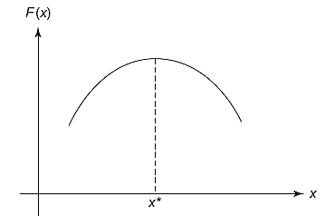
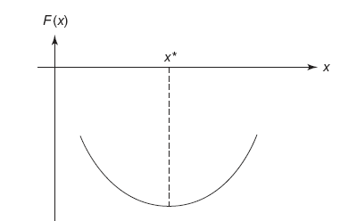

Introduction to optimization theory
Important Observations---Cont.
No restriction on number of inequality constraints
$$p≤n or p≥n$$
General design model treats only minimization problems, let $F(x)$ is maximization function
$$f\left(x\right)=−F(x)$$
$$F(x)$$
$$f\left(x\right)$$

Slide 24
Introduction to optimization theory
Important Observations---Cont.
Standard design optimization model treats only “$≤$ type” inequality constraints, let $G_{l}(x)≥0$ is inequality constraint
$g_{l}(x)$=$−G_{l}(x)≤0$
For inequality constraints $g_{l}\left(x\right)≤0, x^{∗}$is the design point
$$g_{l}\left(x^{∗}\right)=0$$
Active Constraint
$$g_{l}\left(x^{∗}\right)<0$$
Inactive Constraint
$$g_{l}\left(x^{∗}\right)>0$$
Violated Constraint

Slide 25
Introduction to optimization theory
Important Observations---Cont.
For equality constraints $h_{j}\left(x\right)=0, x^{∗}$is the design point
$$h_{j}\left(x^{∗}\right)=0$$
Active Constraint
$$h_{j}\left(x^{∗}\right)≠0$$
Violated Constraint

Slide 26
Thank you for your attention

