Slide 1
Elective 2
Optimal Control Systems
(ACE 326)
Lecture 2- Introduction to Optimization Theory---Cont.
Ref. 1: Chapters 1&2
Dr. Lamiaa M. Elshenawy
Email: lamiaa.elshenawy@el-eng.menofia.edu.eg
lamiaa.elshenawy@gmail.com
Website: http://mu.menofia.edu.eg/lmyaa_alshnawy/StaffDetails/1/ar

Slide 2
Introduction to optimization theory Outlines
More Applications on Optimization Theory

Slide 3
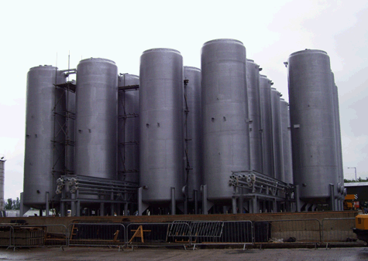
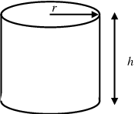
Introduction to optimization theory Optimum design application
Example 2: Design a minimum-cost cylindrical tank
closed at both ends to contain a fixed volume of fluid V. The cost is found to depend directly on the area of sheet metal used.
Step1: Project/Problem Description

Slide 4
Introduction to optimization theory Optimum design application
Step2: Data & Information Collection
The engineering models of this system are:
$$A=2πr^{2}+2πrh$$
$$V=πr^{2}h$$
$c: is the currency cost per unit area$
Step3: Definition of Design Variables
$r=$ radius of the tank, unit
$h=$ height of the tank, unit

Slide 5
Introduction to optimization theory Optimum design application
Step4: Optimization Criteria
The design objective $f(x)$ is to minimize the cost
$f(r,h)=c(2πr^{2}+2πrh$)
Step5: Formulation of Constraints
$$V=πr^{2}h$$
$$r_{min}≤r≤r_{max}$$
$$h_{min}≤h≤h_{max}$$

Slide 6
Introduction to optimization theory How Is Optimization?
$$Summary$$
The optimization problem has the following features:
Single objective
Constrained (equality/inequality)
Continuous
Nonlinear
Static

Slide 7
Introduction to optimization theory Optimum design application
Example 3: A company owns two sawmills and two forests. Each forest can yield up to 200 logs/day, and the cost to transport the logs is estimated at $10/km/log. At least 300 logs are needed daily. The goal is to minimize the total daily cost of transporting the logs.
Step1: Project/Problem Description
Mill | Distance from forest 1 | Distance from forest 2 | Mill capacity per day
A | 24 km | 20.5 km | 240 logs
B | 17.2km | 18 km | 320 logs

Slide 8
Introduction to optimization theory Optimum design application
Step2: Data & Information Collection
Data are given in the table
Step3: Definition of Design Variables
$x_{1}=$ number of logs shipped from Forest 1 to Mill A
$x_{2}=$ number of logs shipped from Forest 2 to Mill A
$x_{3}=$ number of logs shipped from Forest 1 to Mill B
$x_{4}=$ number of logs shipped from Forest 2 to Mill B

Slide 9
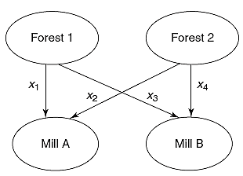
Introduction to optimization theory Optimum design application
Step4: Optimization Criteria
The design objective $f(x)$ is to minimize the cost
$f(x)=10(24)$ $x_{1}$+$10(20.5)$ $x_{2}+10(17.2)$ $x_{3}+10(18)$ $x_{4}$

Slide 10
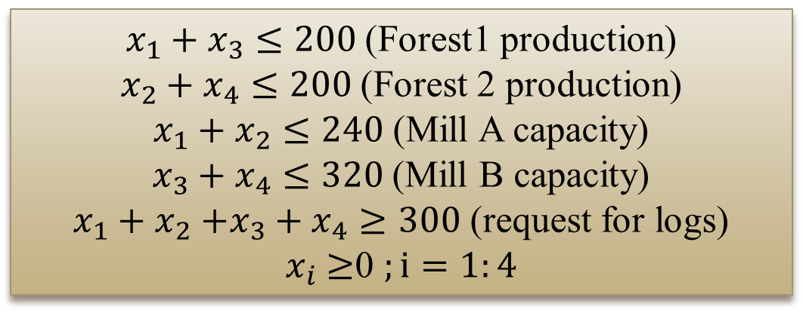
Introduction to optimization theory Optimum design application
Step5: Formulation of Constraints
$x_{1}+x_{3}≤200$ (Forest1 production)
$x_{2}+x_{4}≤200$ (Forest 2 production)
$x_{1}+x_{2}≤240$ (Mill A capacity)
$x_{3}+x_{4}≤320$(Mill B capacity)
$x_{1}+x_{2}$ $+x_{3}+x_{4}≥300$ (request for logs)
$x_{i}$ $≥$0 $;i=1:4$

Slide 11
Introduction to optimization theory How Is Optimization?
$$Summary$$
The optimization problem (transportation problems) has the following features:
Single objective
Constrained (inequality)
Discrete (integer numbers)
Linear
Static

Slide 12
Thank you for your attention

