Slide 1
Elective 2
Optimal Control Systems
(ACE 326)
Lecture 3- Graphical Optimization and Basic Concepts
Ref. 1: Chapter 3
Dr. Lamiaa M. Elshenawy
Email: lamiaa.elshenawy@el-eng.menofia.edu.eg
lamiaa.elshenawy@gmail.com
Website: http://mu.menofia.edu.eg/lmyaa_alshnawy/StaffDetails/1/ar

Slide 2
Outlines
Graphically solve optimization problem
Plot constraints and identify their feasible/infeasible plane
Identify the feasible/infeasible region for an optimization problem
Graphically locate the optimum solution/identify active/inactive constraints
Identify problems that may have multiple, unbounded, or infeasible solutions

Slide 3
Optimization Methods Classification
Optimization Methods
Graphical based
Calculus based
Search based
Linear Programming
Nonlinear Programming
Particle Swarm
Ant colony
Genetic algorithm

Slide 4
Graphical Optimization
Example 4: Plot and identify the feasible/infeasible plane for the following constraints:
$x_{1}≤x_{2}$ b. $x_{1}+2x_{2}≤8$ c. ${3x}_{1}+4x_{2}≤12$
Solution:
Write the equation of any inequality
Write the equation in standard form as
$$\frac{x_{1}}{a}+\frac{x_{2}}{b}=1$$
3. Draw the boundary line with the previous equation
4. Select a test point, e.g. (0,0), substitute into the inequality. If the test point satisfy the inequality feasible plane

Slide 5
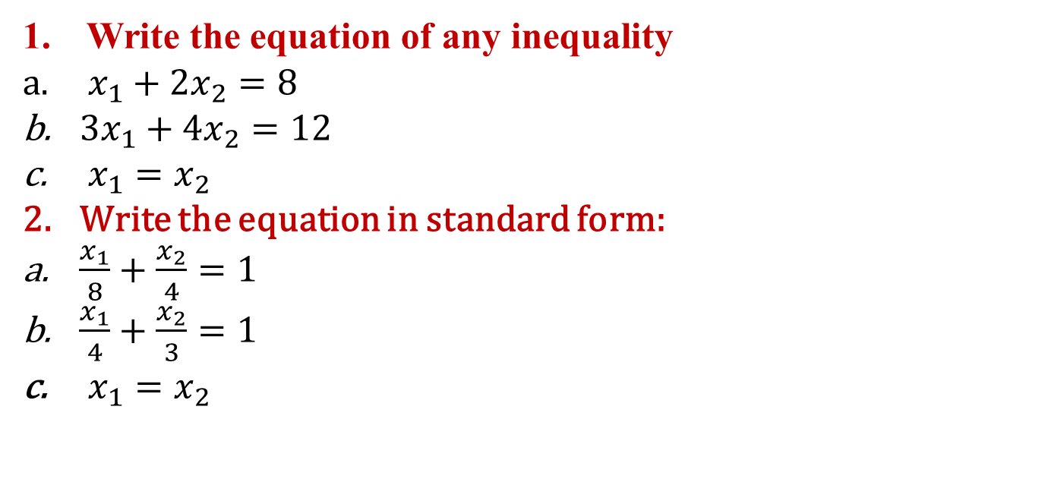
Graphical Optimization
Write the equation of any inequality
$x_{1}+2x_{2}=8$
${3x}_{1}+4x_{2}=12$
$x_{1}=x_{2}$
Write the equation in standard form:
$\frac{x_{1}}{8}+\frac{x_{2}}{4}=1$
$\frac{x_{1}}{4}+\frac{x_{2}}{3}=1$
$x_{1}=x_{2}$

Slide 6
Graphical Optimization
$$Infeasible plane$$
$$Feasible plane$$

Slide 7
Graphical Optimization
$$Infeasible plane$$
$$Feasible plane$$

Slide 8
Graphical Optimization
$$Feasible plane$$
$$Infeasible plane$$

Slide 9
Graphical Optimization
Example 5: Find the collection of all design points $S$ that satisfies the following constraints:
$x_{1},x_{2}≥0$ b. ${3x}_{1}+9x_{2}≤9$ c. $x_{1}+x_{2}<1$
Solution:
Write the equation of any inequality in standard form:
$x_{1},x_{2}≥0$ 1st quadrant
$\frac{x_{1}}{3}+x_{2}=1$
$x_{1}+x_{2}=1$

Slide 10
Graphical Optimization
$$Infeasible region$$
$$Feasible region$$

Slide 11
Graphical Optimization
Example 6: A company manufactures two machines, A and B. 28 A or 14 B can be manufactured daily. The sales department can sell up to 14 A machines or 24 B machines. The shipping facility can handle no more than 16 machines per day. The company makes a profit of $400 on each A machine and $600 on each B machine. How many A and B machines should the company manufacture every day to maximize its profit?
Step1: Project/Problem Description
 | Machine A | Machine B | Upper limit
Manufactured | 28 | 14 | 28 or 14
Sales | 14 | 24 | 14 or 24
Shipping facility | - | - | 16
Profit | $400 | $600 | -

Slide 12
Graphical Optimization
Step2: Data & Information Collection
Data are given in the table
Step3: Definition of Design Variables
$x_{1}=$ number of A machines manufactured each day
$x_{2}=$ number of B machines manufactured each day
Step4: Optimization Criteria
The design objective $f(x)$ is to maximize the profit
$f(x)=400x_{1}$+$600$ $x_{2}$

Slide 13
Graphical Optimization
Step5: Formulation of Constraints
$x_{1}+x_{2}≤16$ (Shipping facility)
$\frac{x_{1}}{28}+\frac{x_{2}}{14}≤1$ (Manufacturing)
$\frac{x_{1}}{14}+\frac{x_{2}}{24}≤1$ (Sales)
$x_{1},x_{2}≥0$ (nonnegative-Integer)

Slide 14
Graphical Solution
Write the equation of any inequality in standard form:
$x_{1}+x_{2}=$16 ( $g1)$
$\frac{x_{1}}{28}+\frac{x_{2}}{14}=1$ ($g_{2})$
$\frac{x_{1}}{14}+\frac{x_{2}}{24}=1$ ($g_{3})$
$x_{1},x_{2}≥0$ 1st quadrant ($g_{4}$ and $g_{5}$)

Slide 15
Graphical Solution

Slide 16
Graphical Solution
E
D
C
A
B
$$Feasible region$$

Slide 17
Graphical Solution
Determine the vertices of the feasible region:
$A(0,0)$, $B(14,0)$, $C(11,5)$, $D\left(4,12\right), and E(0,14)$
Determine the objective function at each vertex:
$f(0,0)=400$(0)+$600$(0)=0
$f(14,0)=400(14)$+$600$(0)=5600
$f(11,5)=400(11)$+$600$(5)=7400
$f(4,12)=400$(4)+$600$(12)= 8800
$f(0,14)=400(0)$+$600$(14)=8400
$$Active constraint$$

Slide 18
Homework
Exercise 1:
$$f\left(x\right)=−x_{1}−0.5x_{2}$$
Subject to $2x_{1}\text{+}3 x_{2}≤12, 2x_{1}\text{+}x_{2}≤8,−x_{1},−x_{2}≤0$
Exercise 2:
$$f\left(x\right)=−x_{1}\text{+}2x_{2}$$
Subject to $−2x_{1}\text{+}x_{2}≤0, −2x_{1}\text{+}{3x}_{2}≤6,−x_{1},−x_{2}≤0$
$$f\left(x\right)=x_{1}\text{+}2x_{2}$$
Subject to $3x_{1}\text{+}{2x}_{2}≤6, 2x_{1}\text{+}{3x}_{2}≥12$
$$x_{1},x_{2}≤5$$
$$x_{1},x_{2}≥0$$
Exercise 3:

Slide 19
Thank you for your attention

