Slide 1
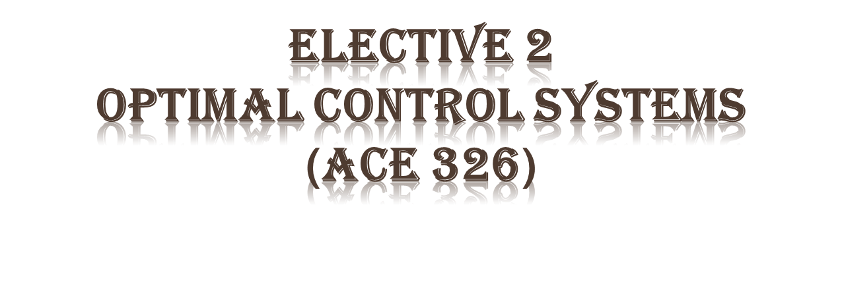
Email: lamiaa.elshenawy@el-eng.menofia.edu.eg
lamiaa.elshenawy@gmail.com
Website: : http://mu.menofia.edu.eg/lmyaa_alshnawy/StaffDetails/1/ar

Slide 2
Course Syllabus
Introduction to Optimization Theory
Optimum Design
Optimal Control

Slide 3
What is Optimization?
Optimization Problem
Data
Efficiency
Cost

Slide 4
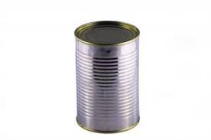
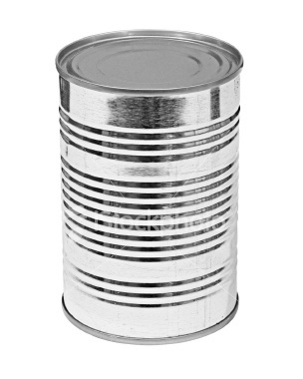
Why is Optimization?
Design an optimum can, i.e.,
V=200 ml
Cost minimum
3 cm ≤ r ≤ 5 cm
5 cm ≤ h ≤ 22 cm
h ≥ 3r
r
h

Slide 5
Modern Control Configuration
Optimal Control
Nonlinear Control
Robust Control
Adaptive Control

Slide 6
What Background Required?
Linear Algebra(vector & matrix algebra)
Basic Calculus (differential calculus & integral calculus)
State Space Analysis

Slide 7
Resources
Textbooks:
JASBIR S. ARORA. Introduction to Optimum Design. Elsevier, 2012.
D. Subbaram Naidu. Optimal Control Systems. CRC PRESS, 2003.
Other References
https://www.youtube.com/watch?v=LL20TZGXp3Q&list=PLbMVogVj5nJQNzJT6sYZpB7H1G6WF0FZ4
http://apmonitor.com/me575/index.php/Main/BookChapters

Slide 8
Timetable
Task | Week | Proportion
Quiz 1 | 5th | 5 Marks
Midterm Exam | 7th | 15 Marks
Quiz 2 | 9th | 5 Marks
Project | 13th | 5 Marks
Final Exam | 16-18th | 70 Marks
Total |  | 100 Marks

