Slide 1
Control System Applications (2)
Programming Logic Controllers
PLCs
Lect. 3
Dr. Tarek Ahmed Mahmoud
Dr. Samah Abdahaleem
2018-2019

Slide 2
Outlines
Control System Components (Review)
Introduction to PLC
What ?
Historical overview (When ?)
PLC Control Systems Advantages (Why?)
Principles of PLC Operation
PLC System Components
PLC Programming
TSX NANO PLCs

Slide 3
Control System Components
Control System Components
Sensors
Actuators
I/P
Controller
O/P
Controlled System

Slide 4
Control System Components
Sensors
Controller
Actuators
sensors
Actuators
I/P
Controller
O/P
1- Sensors (Analog Sensor-Digital Sensors)
2- Actuators (Analog Actuators-Digital Actuators)
3- Controller (Hardwired control- PLC)

Slide 5
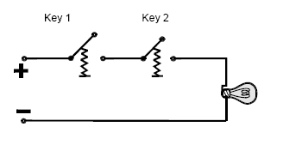
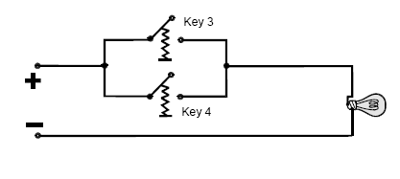
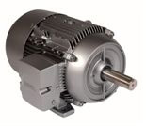
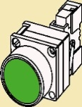
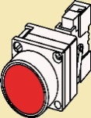
Control System Components (cont.)
SE
Start
Stop

Slide 6
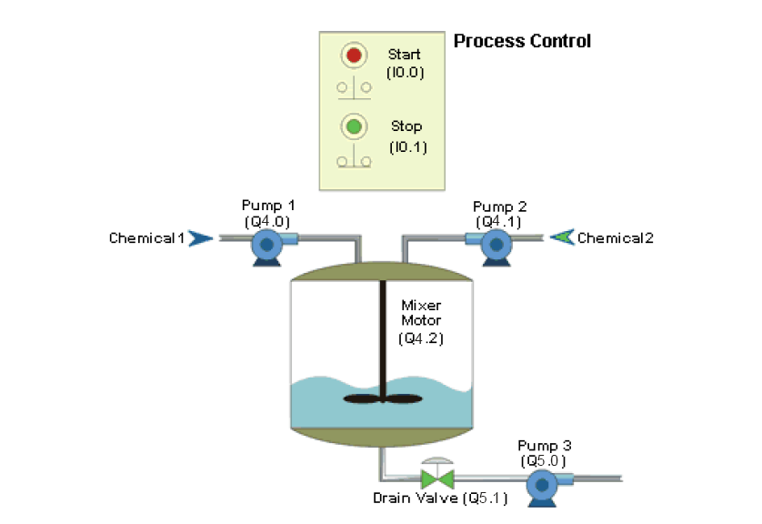
Control System Components (cont.)

Slide 7
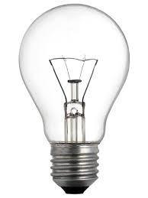
Introduction to PLC
Hardwired control system
What?
+
+
-
-
If key 1 AND key 2 are closed
The lamp is on
Else
The lamp is off
Microprocessor
Key 1
Microprocessor-Controlled System
Key 2

Slide 8
Hardwired control
If key 1 OR key 2 are closed
The lamp is on
Else
The lamp is off
Microprocessor
Key 1
Lamp
Microprocessor-Controlled Systems
Key 2

Slide 9
Microprocessor-Controlled Systems versus Hardwired Controlled Systems
Relay –Logic Circuits
Input devices
Output devices
Program in a microprocessor
Input devices
Output devices

Slide 10
The Programmable Logic Controller (What?)
PLC is a special form of microprocessor-based controller
It uses programmable memory to store instructions and to implement functions such as logic, sequencing, timing, counting, and arithmetic in order to control machines and processes.

Slide 11
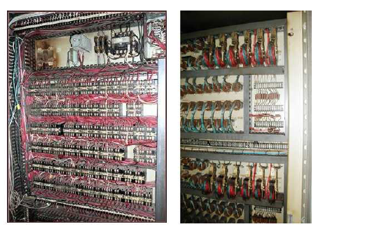
The Programmable Logic Controller (When?)
Motivations
- The control rooms consisted of several walls
- Troubleshooting
- The lack of flexibility to expand the process
Five hours to find it and five minutes to fix it
Birth of PLC
Standard machine controller
- Proposed by Bill Stone , 1968
( He was part of a group of engineers at the General Motors Corporation)

Slide 12
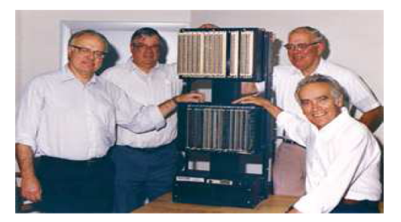
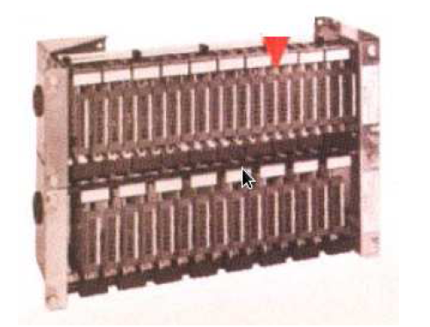
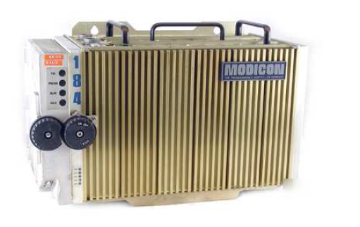
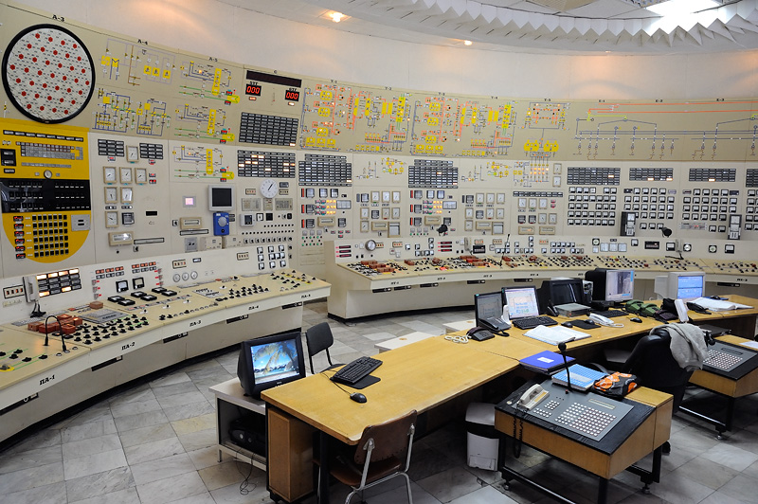
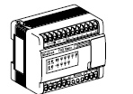
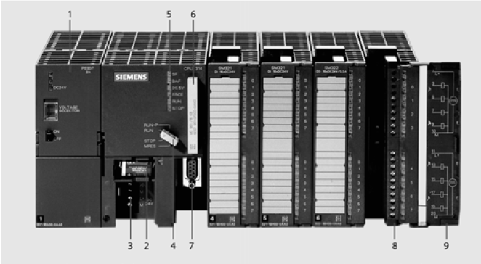
The Programmable Logic Controller (When?)
The Race is on
- Allen-Bradley
- Modicon
- Bedford Associates

Slide 13
PLC Control System (Basic Structure)
Sensors
Actuators
I/P
O/P
O/P
Controlled System

Slide 14
PLC Control System
Sensors
Actuators
I/P
O/P
Advantages
Flexible
Less and simpler wire
Faster response time
Solid-state-no moving parts
Modular design- easy to expand
Sophisticated instruction sets available
Easy to troubleshoot
Less Expensive
Controlled System

Slide 15
PLC System Components
CPU
The power supply unit
The programming device
The memory unit
The input and output modules

Slide 16
PLC System Components (cont.)
Central Processing Unit (CPU)
The internal structure of the CPU depends on the microprocessor concerned
CPUs have
- Arithmetic Logic Unit
- Registers to store the information involved in program execution
- Control unit is used to control the timing of operations

Slide 17
PLC System Components (cont.)
Memory
ROM : Permanent storage for the operating system and fixed
data for the CPU.
RAM : is used for the user’s program
2 parts (blocks of data)
The First block for I/O ports
The second block for preset data, counters, timers
EPROM : is used to store programs permanently (Possibly, as an extra module)

Slide 18
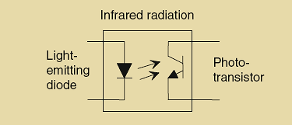
PLC System Components (cont.)
Input/output Units
These units provide the interface between the CPU and I/O devices (sensors and actuators).
Every input/output point has a unique address that can be used by the CPU.
The input/output channels provide isolation
An opt-isolator.

Slide 19
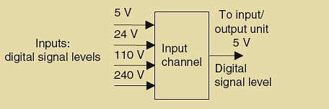
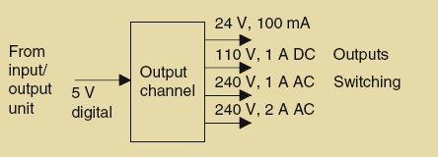
PLC System Components (cont.)
Input/output Units (cont.)
The input/output channels also provide conditioning functions
Input levels.
Output levels.

Slide 20
Input/output Units (cont.)
Output unit types:
Switch small current to higher
Isolates the PLC from the external circuit
Suitable for DC and AC switching
But relatively slow to operate
1- With the relay type
Considerably faster switching action
Optoisolators are needed
Suitable for DC only
But it is destroyed by overcurrent
and high reverse voltage
2- With Transistor type
Optoisolators are needed
Suitable for AC only
But it is destroyed by overcurrent
and high reverse voltage
3- With Triac type

Slide 21
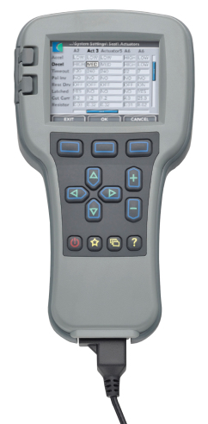
Programming PLCs
The programming Device
1- Handheld programming
device
2- Desktop consoles
3- Personal computers
The program can be stored on the hard disk or a CD and copies can be easily made.

